Slide 1
The Dussehra – Win over 10 Bad instincts within us
Illustrated with characters from mahabharat
By Neeya shetty

Slide 2
Introduction
Ten Bad instincts within us -We have to avoid in life
Kama- desire
Krodh- anger
Lobha- greed
Moha- attachment
Mada- Over Pride
Matsar- jealousy
Swartha –Selfishness
Anyaaya – Injustice
Amanavata – Cruelty
Ahankar - EGO

Slide 3
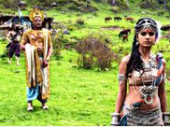
Kama-Satyavati
Because of her desire of wealth, Satyavati told Shantanu that she wanted her sons to be king, and took away something that was rightfully Bhishma’s, and the people of Hastinapur suffered because of that.

Slide 4
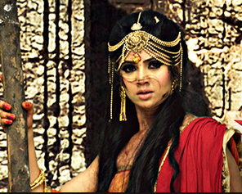
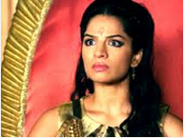
Krodh- Amba/Shikhandini
Amba was so angry at Bishma that she spent her entire life and her next life trying to get revenge

Slide 5
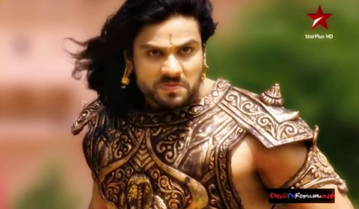
Lobha- Duryodhana
Duryodhana had so much greed for the crown of Hastinapur and wealth of the Pandavas, he started a whole war, and he eventually killed by the Pandavas

Slide 6
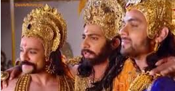
Moha- Dhrithrastra
Dhrithrastra was so attached to his sons, that he did wrong things including sending the Pandavas away for 13 years, and in the end, he lost all his sons

Slide 7
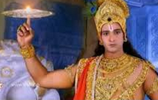
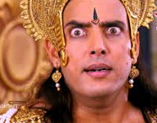
Mada-Over Pride - Shishupal
Shishupal had so much over pride, he kept insulting and doing sinful actions
Vasudev Krishna had promised Shishupal’s mother that he would forgive him 100 times, and finally when he insulted Vasudev Krishna for the 101st time, and then, Krishna killed him with Sudarshan Chakra.

Slide 8
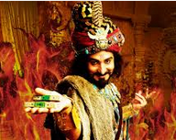
Matsar-Shakuni
Shakuni was so jealous of the Pandavas, he kept cheating everybody, including the Pandavas, Bhishma, and Vasudev Krishna so that his nephews could become wealthy. In the end, all his work was destroyed and he lost all his nephews

Slide 9
Swartha –Selfishness -Duryodhan
Duryodhan was Swarthi as he did not want to give even 5 villages to Pandavas to avoid the Mahabharata War. Ultimately he and his 99 brothers were killed in the war.

Slide 10
Anyaaya – Injustice –Dhrutharashtra
Yudhisthira was oldest son among Kaurav and Pandavas and therefore, he was supposed to get the Kingdom of Hastinapur. But Dhrutharashtra did not make him King and allowed Shakuni to do a trick of playing Shatranj where Pandavas lost the Kingdom and had to live in exile for 13 years. Kauravs did Anyaaya –injustice to Pandavas. Ultimately, Kauravas and Pandavas had Mahabharat war where all 100 children of Dhrutharashtra were killed.

Slide 11
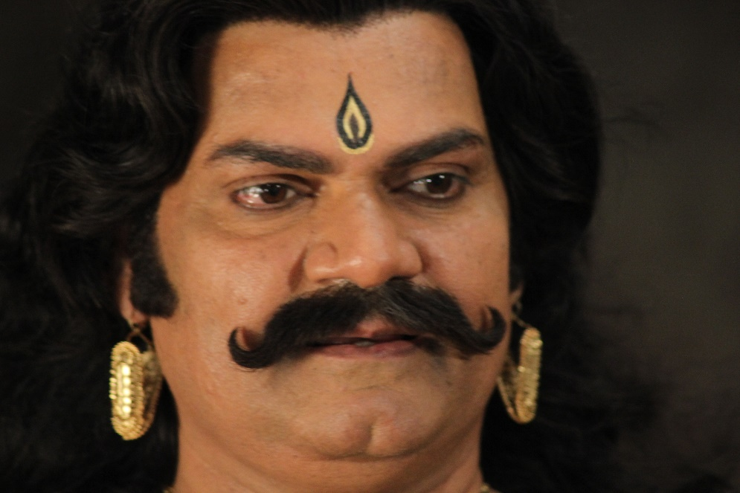
Amanavata – Cruelty -Kansa
Kansa was the brother of Devki (the mother of Lord Krishna). Kansa killed 7 New born children of Devki in the prison. The act of cruelty was so extreme that Lord Krishna had to take birth and kill him.

Slide 12
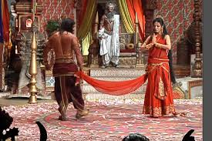
Ahankar – EGO - Draupadi
When Duryodhana tried to enter a door, he hurt his head because it was not really a door but a wall. When he went further he saw a pool of water and tried to enter it. It was not a pool but glass which looked like a pool. He hurt his foot with the glass. Bhima and the other Pandavas who were present there were amused and made fun of him when they saw this.
Then Duryodhana went ahead but fell in a pool, which looked just like the floor. Seeing this, Draupadi, the Pandavas' wife, started laughing loudly. She commented, "A blind man's son is also blind." This rude comment insulted and hurt Duryodhana’s “EGO” so much that he vowed to take revenge on Draupadi.

Slide 13
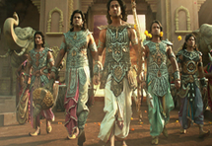
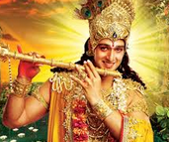
Remove all ten bad instincts
As people of this world, we should never follow these ten bad instincts and we should be like the Pandavas, Drapudi, and Bhishma, and follow Vasudev Krishna

Slide 14
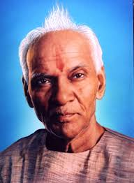
Conclusion
Meaning of Salvation
Salvation is to be free from bondage. We must deliberate on the true meaning of the bondage - we are not literally tied up, needless to say. So what is this bondage that we seek to free ourselves from?
These shackles are the ones of our own flaws and negative tendencies such as self-centered thinking, narrow mindedness, anger, egoism, greed, and attachment. Weakness of one's inner self is the biggest bondage. We can attain salvation in this life, right here and starting right now, by redefining our perspective. We don't have to wait.--Pt. Shriram Sharma Acharya
Gurudev Pt. Shriram Sharma Acharya

