Slide 1
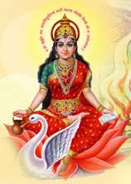
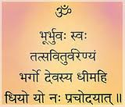
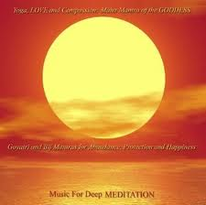
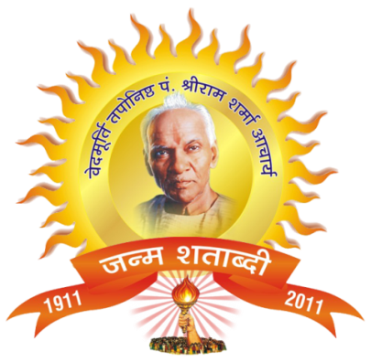
The Science and Philosophy of
Gayatri Mantra
||Om bhur bhuvah swah tat savitur varenyam bhargo devasya dheemahi dhiyo yonah prachodayat ||

Slide 2
What is Gayatri Mantra?
*Greatest Mantra on the Earth
*Only mantra – made by God (Lord Brahma)
*a combination of 24 syllables, that generates unusual powers
*A prayer for sudbuddhi – Righteous wisdom
*Gayatri mantra uses no god’s name and is therefore a universal mantra and can be fitted into any religion

Slide 3
Evolution of Gayatri Mantra
Lord Vishnu wanted to manifest Himself in multiple forms (Ekoham bahusyami )
Lotus appeared from His naval and He created Lord Brahma and gave him a job to create a universe where He can manifest in many different forms.
Lord Brahma created 5 essential elements (earth, sky, water, air, fire). The atoms of which combined with one another and formed physical bodies. The energy He used to create Nature (Prakriti) is called, –Savitri.
Lord Brahma then made them alive by putting Life Force (Pran-Fraction of God) in each of them. The energy He used to put PRAN is called - Gayatri.
Lord Brahma created a 24 syllable Mantra (the great Gayatri Mantra) as a guide for how to live life; Our politics, economics, health, Dharma, desires etc. ||Om bhur bhuvah swah tat savitur varenyam bhargo devasya dheemahi dhiyo yonah prachodayat ||

Slide 4
People heard the meaning of each syllable of this greatest mantra in divine voices (Shrvan – hearing). They explained it to others. Thus a lot of knowledge accumulated.
Rishi Krishnadwaipayan Vyasa – compiled all knowledge into four classes: Rigveda(Dharma), Samveda(Desires), Yajurveda(Politics), Atharvaveda(Economics)
Vedmata Gayatri:
Vedas were born from this greatest mantra. So Gayatri is known as Vedmata Gayatri.
Vishwamata Gayatri:
The whole universe was created with this super power. So Gayatri is known as Vishwamata Gayatri.
Devmata Gayatri:
This is the only mahamantra which can awaken divinity in human being, so Gayatri is known as Devmata Gayatri.

Slide 5
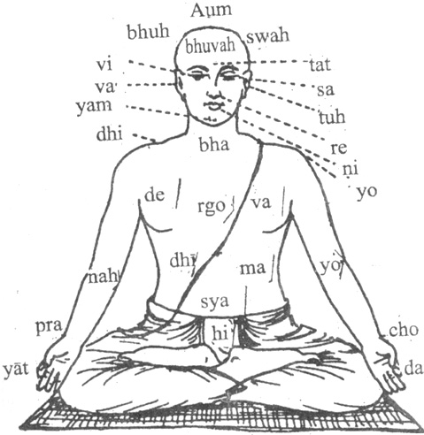
Science of Gayatri Mantra
The human body has 7 power centers and 72,000 glands which all have openings in the mouth. These glands have positive or negative functions. As you speak, wherever the tongue touches in your mouth, connected gland is activated. So you see the result of that gland’s function. 24 syllables of Gayatri Mantra activate those glands that generates unusual results!!

Slide 6
Sound Effect of Gayatri Mantra
Syllable | Gland Activated | Result | If you noticed, it is a result of …….. Sadhana
tat | tapini | success | Ganesh- success in difficult tasks
sa | safala | valour | Narsinh- hardwork, courage, and protection
vi | vishva | protection | Vishnu- increases positive strenghts
tur | tusti | kalyan | Shiva- creates positive environment
va | varada | yog | Krishna- strength to do duties without expectations
re | revati | love | Radha- love despite conflicts
ni | sookshma | wealth | Laxmi- you will receive wealth
yam | gnyana | tej | Agni-makes you talented and charismatic
bhar | bharga | raksha | Indra- protection from negitivity
go | gomati | intellect | Saraswati- long term benefiting thoughts
de | devika | suppression | Durga- gives you the ability to remove obstacles
va | varahi | loyalty | Hanuman- increases loyalty towards Ideal
sya | sihhini | retention | Mother Earth- tolerance, patience, forgiveness

Slide 7
Sound Effect of Gayatri Mantra (cont)
Syllable | Gland Activated | Result | If you noticed……..
dhee | dhyana | vitality | Sun god- good qualities
ma | maryada | sayam | Ram- stick to goals despite obstacles
hi | sfuta | penence | Sita- tap shakti
dhi | medha | farsightedness | Chandra – Removal of greed, attachment etc.
yo | yogmaya | awakening | Yam – Removal of fear, laziness, being alert
yo | yogini | productivity | Brahma- more productivity
nah | dharini | Nice/sweet | Moon- cools you down
pra | prabhava | ideal | Narayan- makes you a perfectionist
cho | ushma | courage | Haygreev- gives courage, fearlessness, and effort
Da | dhrashya | Vivek wisdom | Swan- strength to decide between right and wrong
yat | niranjana | Selfless service | Tulsi- seva/help the needy

Slide 8

The Power of Sound is well known
Origin of Universe
Big Bang Theory
Vedic affirmation of the eternal omnipresent Omkar
Medical field
Infrasound
Ultrasound
EEG
Echocardiograms
NMR-MRI
Emotions (Effect of Music)
Kindle a lamp, invite clouds & rains in dry sky
Cure complicated psychiatric & psychosomatic disorders
Voice
Sharpens one’s personal & social life via communication
Sympathetic words offer instant healing
Discouraging words frustrate & discourage
Power of speech makes/shakes destiny of societies/nations

Slide 9
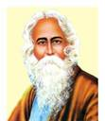
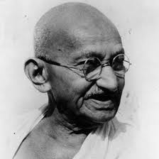
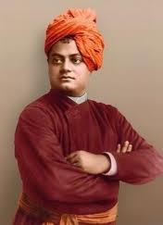
Exaltations of Gayatri by Dignified Personalities
It is the Gayatri Mantra which has awakened India and which is so simple as can be chanted in one breath, There can be no scope for any logical discussion, difference of opinion or any dispute in the study of this holy Mantra. _ _ _ _ _ Rabindranath Tagore
Mahatma Gandhi: Constant chanting of Gayatri Mantra is very useful in healing the diseased and elevating the soul. Gayatri Japa is practiced with a steady mind and pure heart is capable of removing obstacles and calamities during bad times.
Swami Vivekanand: Only that thing should be asked for from a king which befits his dignity. The only thing fit to pray from God is wisdom. God grants wisdom only to those with whom he is pleased. Wisdom makes a man go on the right path. Man gets all sorts of happiness by Sat karmas. Gayatri Mantra is a Mantra for wisdom and hence it is called the crown of all Mantra.

Slide 10
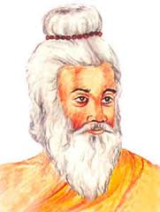
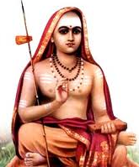
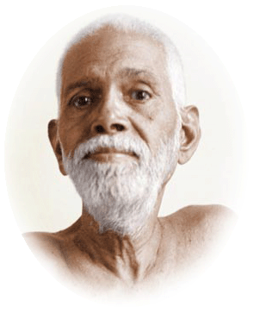
Yogiraj Yagnyavalkya: Gayatri is the mother of Vedas, it destroys sins and there is no other greater purifying mantra than Gayatri on this earth as well as in the heavens. Just as there is no better place of pilgrimage than Ganga, there is no mantra superior to Gayatri mantra. The one who masters Gayatri becomes master of all knowledge. A dwij who is not devoted to Gayatri is like a shoodra. He who does not know Gayatri gets deprived of Brahmantva and becomes sinful.
Jagat Guru Shankaracharya: It is beyond human competence to describe the glory of Gayatri. Nothing is more important in the world than to attain spiritual wisdom, which is inspired by Gayatri Sadhana. Gayatri is the primordial mantra. Its sadhana destroys sins and promotes virtues.
Raman Maharshi: Of all the masteries, the mastery of mantra is extremely powerful. Marvelous results are achieved by the power of Mantras. Gayatri is such a mantra, which bestows both material as well as spiritual benefits.

Slide 11
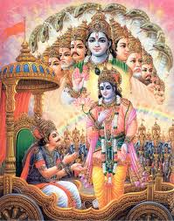
Of the Sam-Veda hymns I am the Brhat-sama, among the Mantras, I am Gayatri, among the months, I am the harvest month of fall and among the seasons, I am Spring
Lord Krishna -Bagavad Geeta (Chapter-10, verse-35)

Slide 12
Gayatri Philosophy (Tatvadarshan)
Gayatri
Her Triple Currents
Saraswati-Brahma
Lakshmi-Vishnu
Kali-Shiva
Creation
Nourishment
Dissolution
Causal Body
Subtle Body
Physical Body
Upasana
Sadhana
Aradhana
From above triple currents emerges triplets such as listed below
1

Slide 13
Meaning Of Gayatri Mahamantra
1. Om Bhur, Bhuvah, Swaha – Bhakti yog
Om: Name of God
Bhur – Pran-swaroop – Sadhak gets vitality. More vitality you have:
more overall resistance you have for everything,
more immunity to diseases,
You have more divine qualities
Helps you remove your demonic qualities
You have an aura that influences others in a positive way.
Bhuvah – Dukh Nashak – Removes pain,
Swaha – Bestow happiness to the Sadhak
Good times and Bad times are basically our perceptions. Gayatri Mantra changes our perception. So whatever situations used to bother us before, now seem very ordinary. Sadhak experiences piece and tranquility all the time.
This first part of Gayatri Mantra develops Bhakti yog in Sadhak.
He develops the feeling of “Atmavat Sarvabhooteshu”, (Treat others
the way you like to be treated) .

Slide 14
2. Tat Savitur Varenyam Bhrgo Devasya Dheemahi: Gyan Yog
Tat : That – God, who ever you believe in.
It fits to any God, e.g. Shiva, Vishnu, Jesus, Mohammad Paigambar etc.
Savitu: Illuminant like Savita(energy because of which the sun is illuminant)
Gayatri Sadhak also becomes Tejasvi like Sun.
Varenyam: The best. Varan karne yogya.
God is The best. We like to have God’s qualities in us.
Gayatri Sadhak also becomes the best by improving his character. He becomes role model (Varan karne yogya) for others.
Bhargo: Destroyer of sins.
Bharg word of Gayatri mantra washes of our Accumulated actions (Sanchit Karma) and minimizes our destiny (Prarabdha). Unless our karmas become NULL we do not get salvation. But with help of Gayatri Mantra we can get rid of our Karmas, thus it gives – Brahmavarchasam!
….. Continue…

Slide 15
2. Tat Savitur Varenyam Bhrgo Devasya Dheemahi: Gyan Yog
Devasya: To awaken divinity.
Gayatri mantra awakens divinity in you.
We have all the power centers already in our body. But they are in inactive state. Sound energy of Gayatri mantra activates them and gives unusual powers to the sadhak. Sadhak develops will power to remove his bad qualities and increase divine qualities.
Dheemahi: To imbibe or inculcate.
Thus the second fraction of Gayatri mantra gives you the knowledge (Gyan yog) that “I have the God, who is illuminant like Sun(Savitu), who is the best among the best(Varenyam), who is a destroyer of sins(Bhargo), who awakens divinity(Devasya), inside me. This reminds you of “Who you are?”, which makes you SPIRITUAL in day to day life.

Slide 16
3. Dhiyo yon aha prachodayat – Karmayog
Dhiyo: Buddhi – Intellect
Yo: Lead to a righteous path
Nah: Our
Prachodayat: Forcefully
Lead all our intellect to the righteous path.
This forcefully makes us do our duty in whatever situation we are. Thus we become Karma-yogi. We do everything as “our duty” without worrying about the fruit of our actions.

Slide 17
Gayatri is a Kamdhenu, Kalpavruksha and Paras
Gayatri Sadhana gives unusual results…
Dvijanam – Makes you Dvij – Brahmin – Your thinking becomes selfless like a Brahmin
Ayuhu – Gives long life
Pranam – Gives Vitality – Relieves stress, immunity, you become more mature, increase divine qualitiwes, decrease demonic qualities etc.
Prajam – Creates protective sheath around the children of the Sadhak
Pashum – Sadhak gets wealth
Keertim – Since Gayatri is Hrim, Shrim, Klim, Her sadhak gets knowledge, wealth and purity. He is able to help others. Thus he gets respect from the society.
Dravinam – Money.
Brahmavarchasam - Salvation

